Slide 1
Secure data hiding in image using steganography
CAPSTONE PROJECT
Presented By:
Student Name : Harikrishnan G V
College Name : RVS Technical Campus Coimbatore
Department : BE. Computer Science Engineering

Slide 2
OUTLINE
Problem Statement
Technology used
Wow factor
End users
Result
Conclusion
Git-hub Link
Future scope

Slide 3
Problem Statement
The objective of this project is to develop a method for securely hiding sensitive data within digital images using steganography, with an emphasis on encryption and decryption. The primary goals are to embed secret information within an image without noticeably altering its appearance and to reliably extract and decrypt the hidden data when needed. By using encryption techniques in conjunction with steganography, the hidden data will be protected against unauthorized access and tampering. A practical application of this project is securely transmitting confidential information over the internet by embedding it within images, thereby reducing the risk of interception and unauthorized access.

Slide 4
Technology used
Platform
Windows11: The code is written to run on the Windows operating system.
Python Programming Language
Used for writing the code.
OpenCV Library
Used for reading and writing images.
Dictionaries
Convert characters to numbers and back.
Steganography Technique
Hide data inside image pixels.
Encryption
Protects hidden data with a passcode.
User Input
Enter secret message and passcode.

Slide 5
Wow factors
Combination of Steganography and Encryption:
Integrates both techniques to securely hide and protect data within images.
User-Friendly Interaction:
Simple and interactive user input for entering secret messages and passcodes.
Maintained Image Quality:
Secret data is embedded without noticeably altering the image's appearance, preserving its quality.
Robust Security:
Hidden data is encrypted and requires a passcode for decryption, ensuring authorized access only.
Efficient Implementation:
Uses Python and OpenCV for efficient image processing and manipulation.

Slide 6
End users
1️⃣ Cybersecurity Professionals – Use steganography for secure data transmission and covert communication.
2️⃣ Forensic Experts – Extract hidden information from images for digital investigations.
3️⃣ Government & Defense Agencies – Securely embed sensitive data in images for intelligence and confidential operations.
4️⃣ Researchers & Academics – Study and improve steganographic techniques for data security and cryptography.
5️⃣ Privacy-Conscious Users – Individuals who want to protect personal or confidential information from unauthorized access.

Slide 7
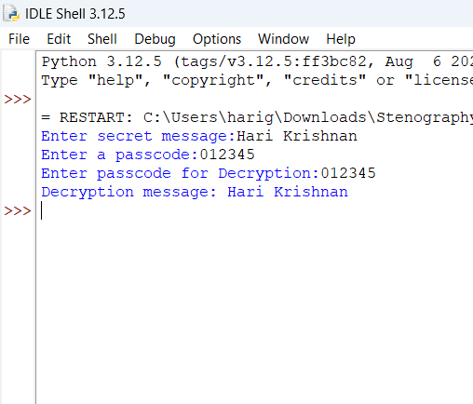
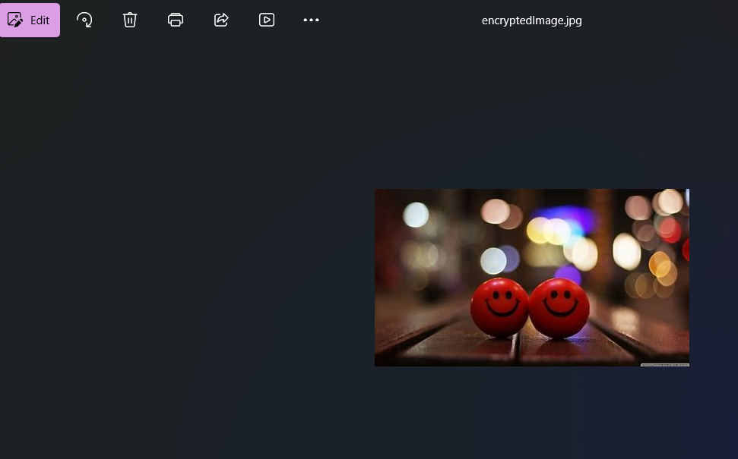
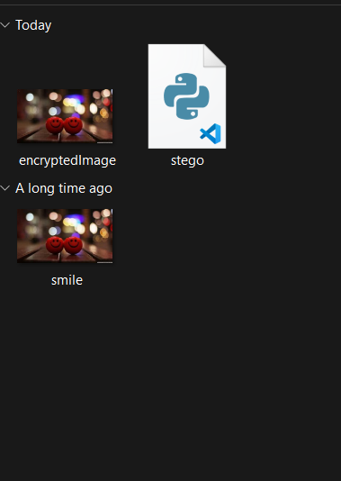
Results

Slide 8
Conclusion
In this project, we successfully developed a method for securely hiding sensitive data within digital images using steganography, with an emphasis on encryption and decryption. By embedding secret messages within image pixels and encrypting them with a passcode, we ensured that the hidden data remained protected from unauthorized access and tampering. The project maintained the visual quality of the images, making the hidden data imperceptible to the human eye.
Through the use of Python programming, the OpenCV library, and simple user interactions, we created a user-friendly and efficient solution for secure data transmission. This project demonstrates the practical applications of steganography and encryption, providing a valuable tool for privacy enthusiasts, businesses, educators, researchers, and developers.
Overall, the project showcases the potential of combining steganography and encryption techniques to enhance data security in today's digital age. It serves as an excellent example of how innovative approaches can be used to protect sensitive information and maintain privacy in digital communications.

Slide 9
GitHub Link
https://github.com/Harikrishnangv/steganography.git
Description:
This project implements steganography to hide and extract secret messages within images.
Repository Contents:
📂 Source Code – Python programs for embedding and extracting hidden messages.
📂 Sample Images – images used for testing steganography.
📂 Presentation – PPT slides summarizing the project.

Slide 10
Future scope(optional)
🖥️ Graphical User Interface (GUI) – Develop a user-friendly GUI to make embedding and extracting messages easier.
📂 Drag and Drop Support – Allow users to select images and messages through a simple drag-and-drop interface.
🛠️ Customization Options – Provide settings for users to adjust the encoding method and choose different bit depths.
📊 Real-time Preview – Show a preview of the image before and after steganography is applied.

Slide 11
THANK YOU

